Slide 1
Risk Benefit
Updated 3rd December 2016

Slide 2
What could possibly go wrong?
And to whom?

Slide 3
Why do
we do this? What do we
get out
of it?

Slide 4
A Sense of Priorities?
Prioritise
Highest
Lowest

Slide 5
A Sense of Balance?
Risks
Benefits
What are the hazards that could harm? | Who might be harmed & how? | How likely is it to happen? | Actions to reduce the risk?
What are the good outcomes? | Who might benefit and how? | How likely is it to happen? | Actions to increase the benefit?

Slide 6
A Sense of Balance?
Risks
Benefits
For you?
For yours?
For those in your professional care?

Slide 7
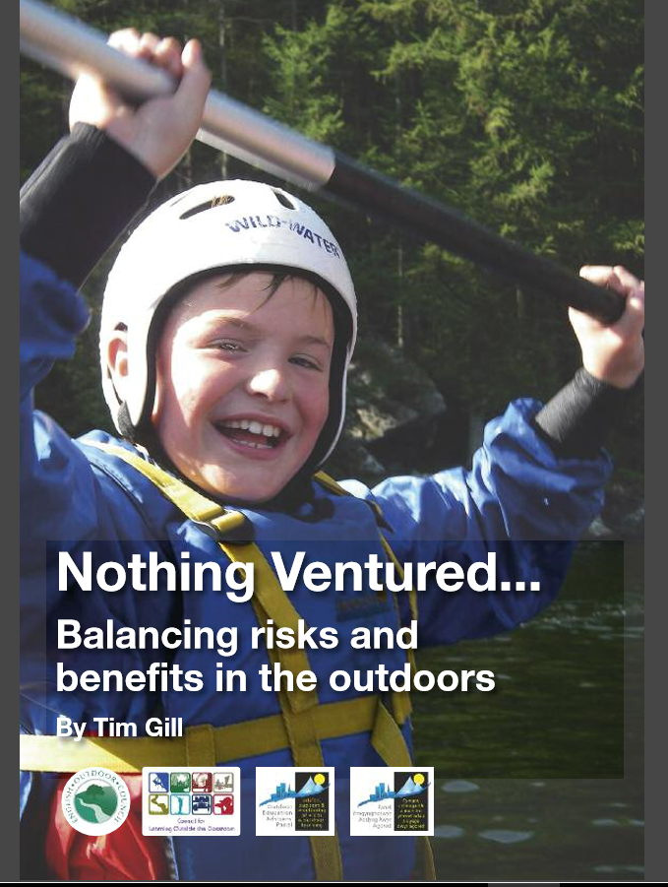
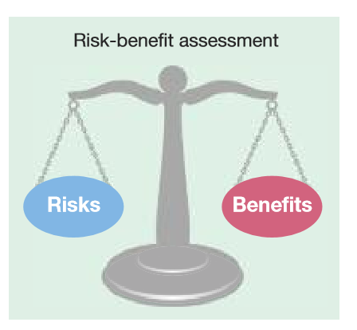
http://www.englishoutdoorcouncil.org/wp-content/uploads/Nothing-Ventured.pdf

Slide 8
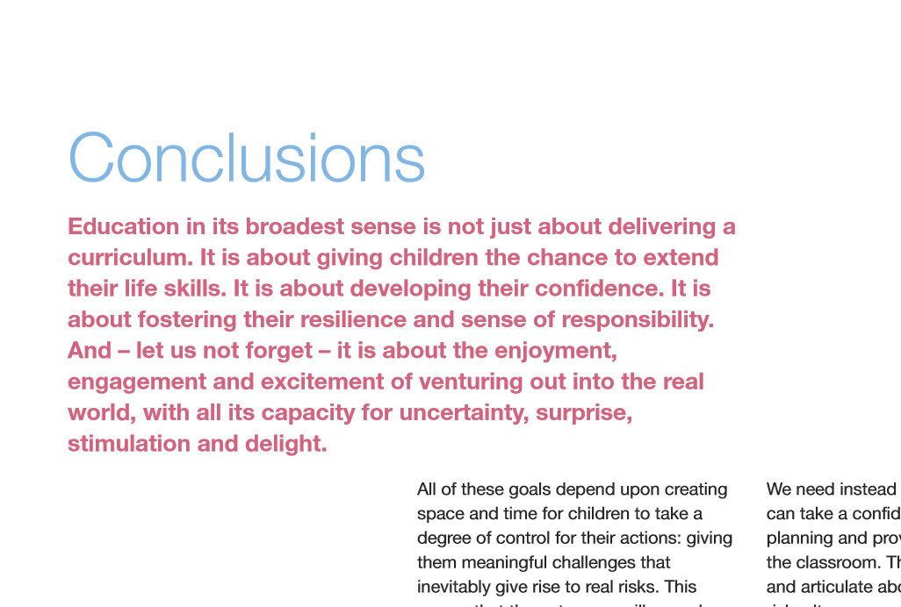

Slide 9
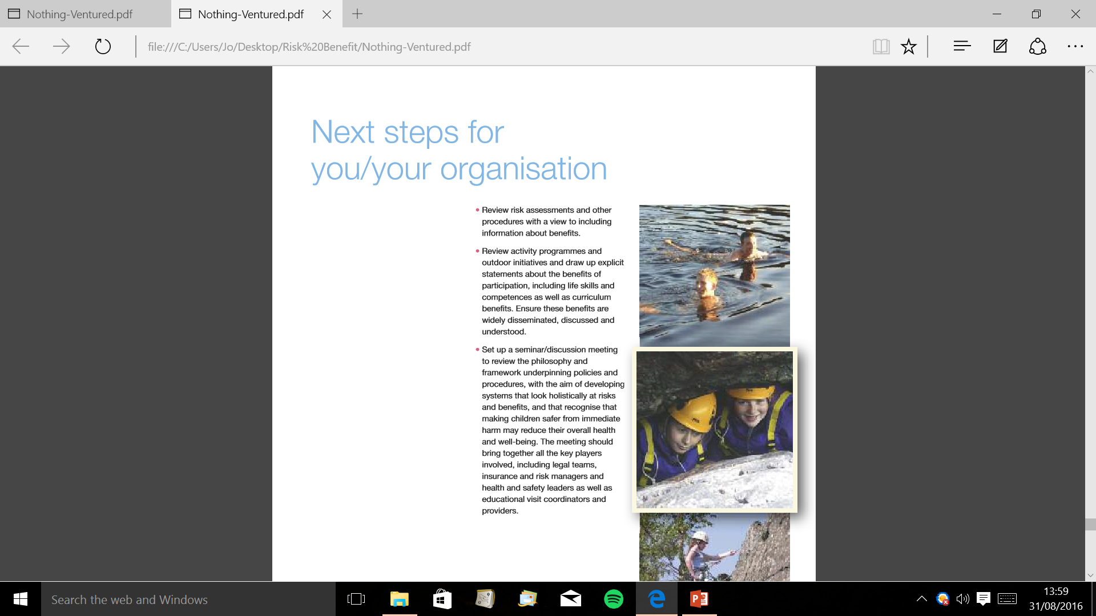

Slide 11
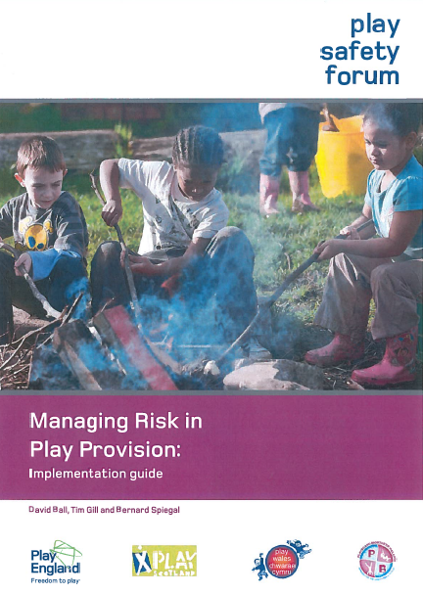
Competent person
• Every employer shall… appoint one or more competent
persons to assist him in undertaking the measures he
needs to take.
A person shall be regarded as competent where he has
sufficient training and experience or knowledge and
other qualities.
Where there is a competent person in the employer's
employment, that person shall be appointed… in
preference to a competent person not in his employment.
• Management of Health & Safety at Work Regulations 1999

Slide 12



Jo Barnett
Outdoor Education Service Manager
Telford and Wrekin
jo.barnett@telford.gov.uk
Office: 01952 382057 Mobile: 07973 716547

