Slide 1




Telford Snowboard and Ski Centre

Slide 2
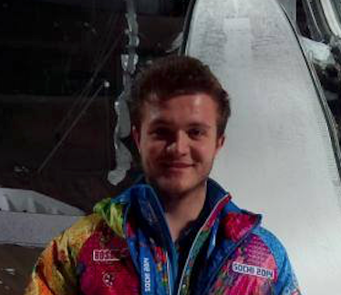
Telford Snowboard & Ski Centre
About us
Local authority leisure facility operating for over 40 years
85 meter long dry slope
35 meter nursery slope
Hub site for Snowsport England
Over 30 Qualified/Experienced instructors
Chris Blagden, Alpine skier attended 1992 Winter Olympics in Albertville,
France
Where
North - 31 miles from Whitchurch, Tamworth – 56 miles, Chill Factor 51 miles
West - 51 miles from Oswestry, Tamworth – 69 miles, Chill Factor 68 miles
South - 51 miles from Ludlow, Tamworth – 61 miles, Chill Factor -113 miles
North/East - 13 miles from Newport, Tamworth 36 miles, Chill Factor – 65 miles
SSE Schools week
Snow sport England
Luke Williams SSE
Events & Campaigns Lead
luke@snowsportengland.org.uk

Slide 3
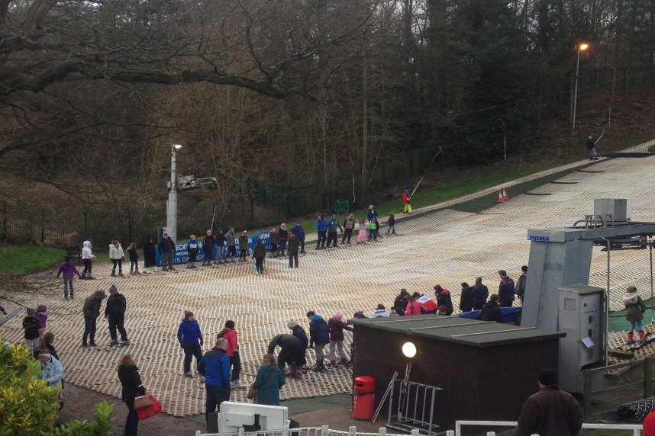
Making the most of skiing educational visits
Barbara Knapp defined skill as “the learned ability to bring about predetermined results with maximum certainty and often with minimum outlay of time or energy or both”
Increased experience and value
Efficient time abroad spent on the slope
Understanding your equipment pro’s/cons
Greater awareness of mountain environment
Fitness – skills, agility, technique
Learn to ski from £6.50
- Tamworth £12 for 55 minutes
- Chill Factor £150 for 1 day course

Slide 4
Ski-Way Code
RESPECT FOR OTHERS
Be aware of all skiers around you and do not endanger them. Give priority to skiers downhill of you. When overtaking or crossing the path of another skier, it is your responsibility to ensure that you do not collide or cause him/her to fall.
CONTROL OF SPEED
Only ski within the limits of your ability and be sure you can always stop safely.
CHOICE OF ROUTE
Pick your route carefully and be prepared to handle changing situations with other skiers/boarders and the mountain itself.
OVERTAKING
Always allow space for others to make their turns and remember that those ahead of you have right of way. The slower skier/boarder also has right of way.
START IN SAFETY
Look up and down before starting off or entering a piste and ensure enough space to avoid the path of other piste users.
STOPPING ON THE PISTE
Never stop to rest in the middle of a piste or on blind corners or sudden drops. Get to the side of the piste where it is safer. After a fall, move quickly to the side.
RESPECT FOR SIGNS AND MARKINGS
Always obey signs. They provide vital information for YOU and YOUR safety on the mountain.
HELP AT ACCIDENTS
IDENTIFY YOURSELF AT AN ACCIDENT
Understand accident procedures and be prepared to help. Witnesses must provide names and addresses.
Snowsport England advises that you remember to never ski alone. Always ski in a group of at least 4 and, in the event of an accident, two people can seek help while the other can remain with the injured person.

Slide 5

Role of Telford Snowboard & Ski Centre
ASSI/BASI Level1-4 Instructors & Level 1Tutor
Increase sport participation
Structured teaching programme
Guidance on equipment and practical safety advice
Tailor made school packages
Flexible booking arrangements
Eddie the Eagle visits Telford
Eddie the Eagle

Slide 6
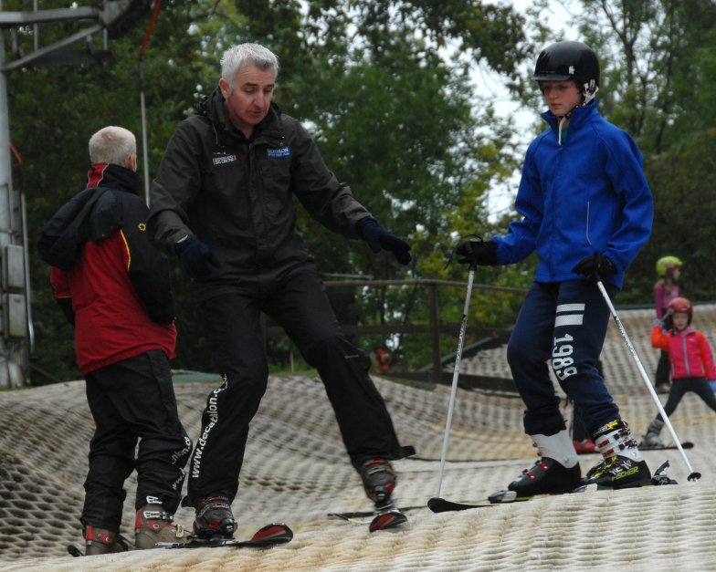
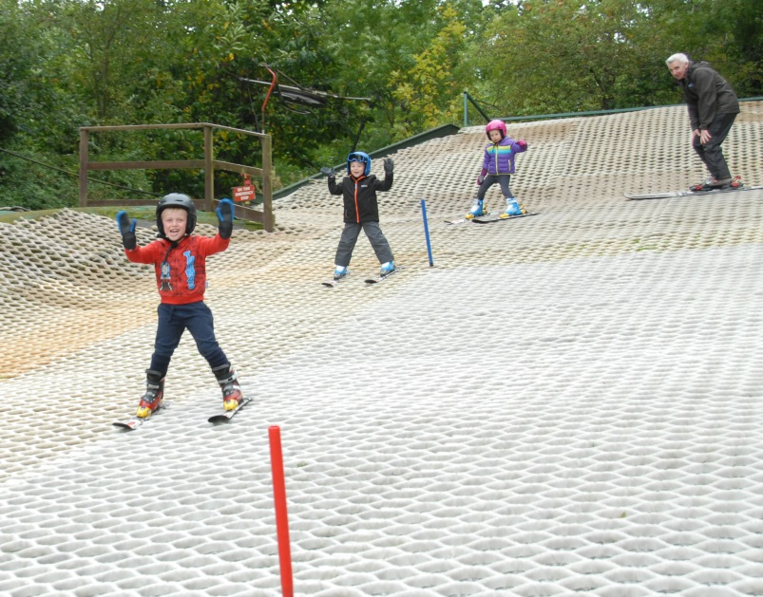
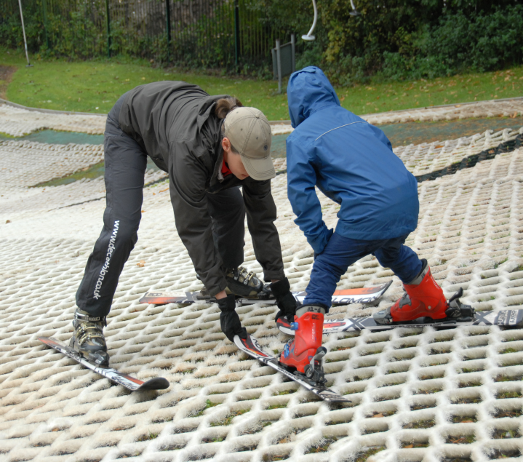
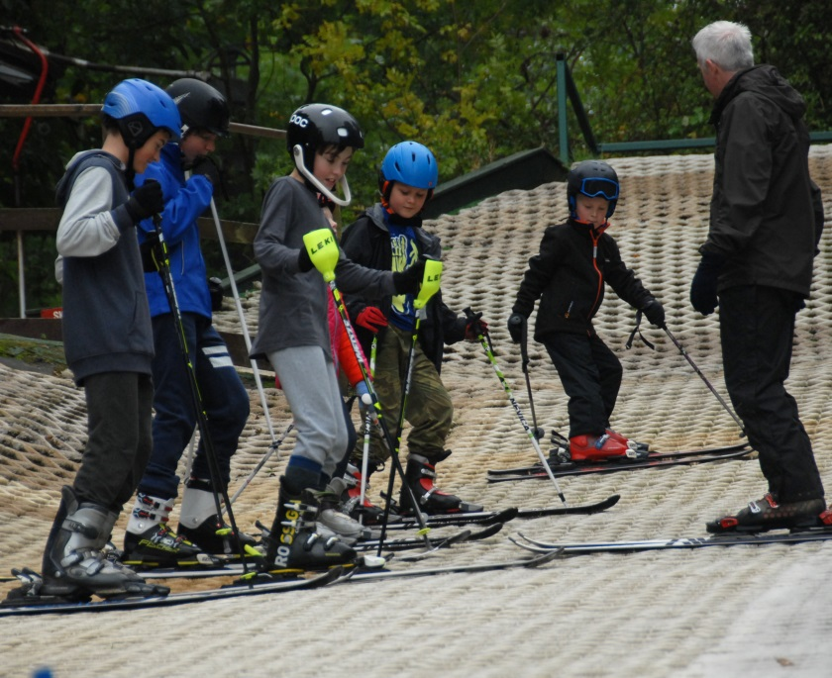
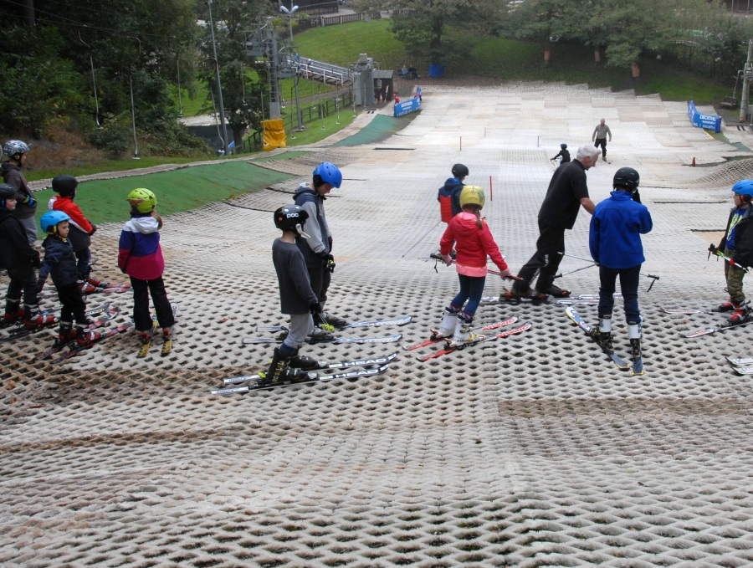
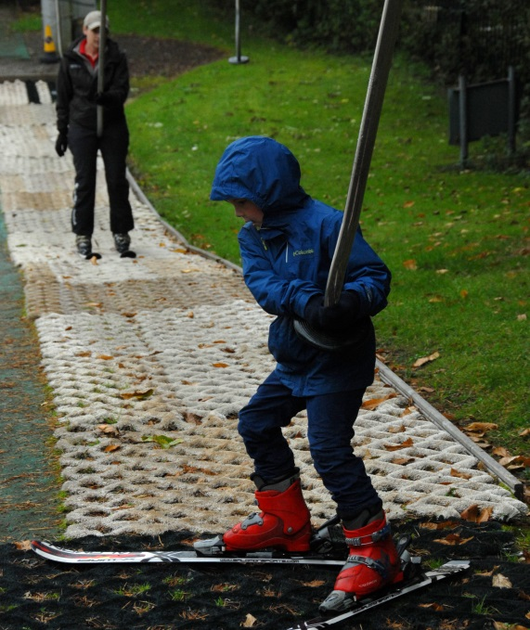
Questions

Slide 7
Contact us
Address: Court St, Madeley, Telford TF7 5DZ
Phone: 01952 382688
Email: madeleyskicentre@telford.gov.uk
James.Craig@telford.gov.uk
Nigel.Buckley@telford.gov.uk
Useful web links
http://www.telfordandwrekinleisure.co.uk/ski
https://twitter.com/telfordslope?lang=en
https://www.skiclub.co.uk/uk-slopes-map
https://snowsportengland.org.uk/
http://www.uksnowsports.co.uk/
https://www.nssw.co.uk/

